Slide 1
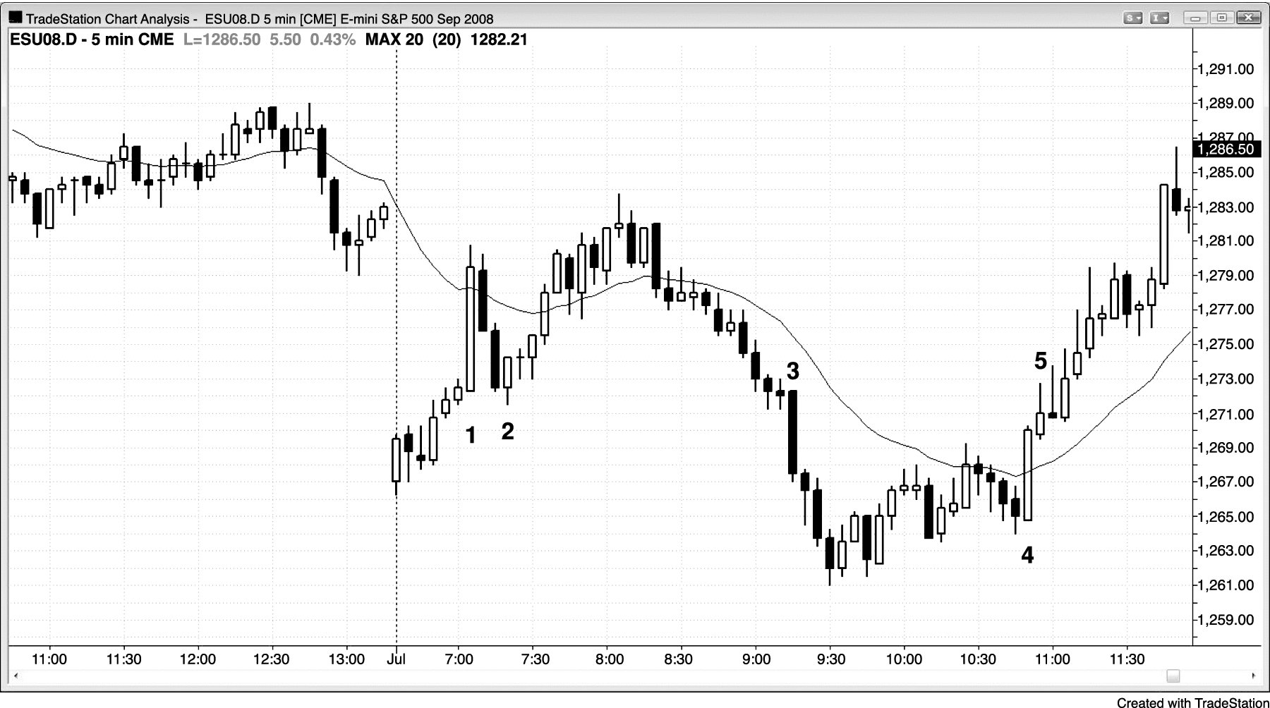
FIGURE 10.1 Big Trend Bar Extremes Are Magnets

